Slide 1
Physical examination
General

Slide 2
How to start
W ash hand before and after, wear gloves where appropriate
I ntroduce yourself to the patient and seek his or her consent
P osition the patient correctly
E xpose the patient as needed
R ight side of the bed

Slide 3
First impression
What can you see at the first glance at the patient?
Habitus
level of consciousness
patient position, posture, gait
body type – constitution
Vital signs
Nutrition

Slide 4
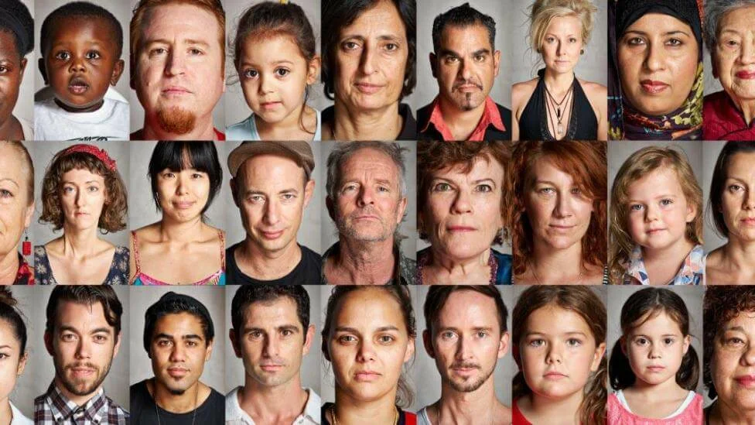
Habitus (Lat. habitus appearance, external appearance) — the appearance of a person: features of the physique, posture, skin color, facial expression, etc., by which it is possible to judge the state of health of a person, the disease he has or the predisposition to any diseases.

Slide 5
Level of consciousness
Obnibulation-the degree of impairment of consciousness, in which limited verbal contact is maintained and the person's own activity is reduced Somnolention-it is characterized by a long and deep sleep, from which the patient can wake up with the use of vigorous stimulation
Stupor-is a physical and mental disorder, expressed in the form of numbness, as well as partial or complete immobility.
Sopor-accompanied by a shutdown of consciousness, with the preservation of protective reactions, opening the eyes to pain, the least short-term verbal contact;
Coma-complete loss of consciousness

Slide 6
Patient position
Active
Passive
Forced position

Slide 7
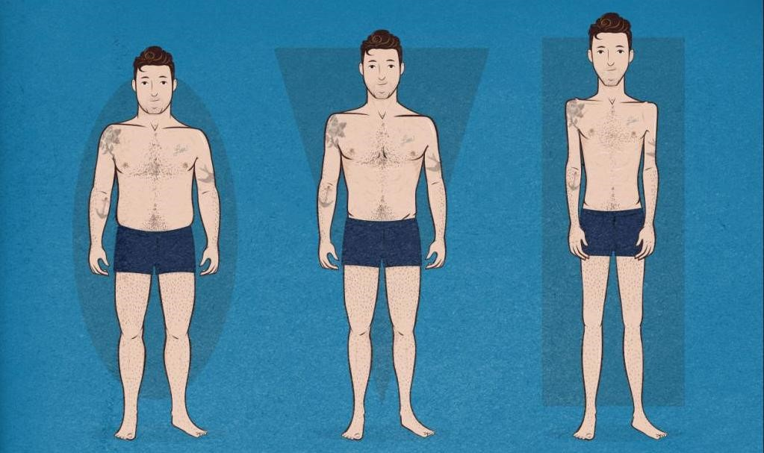
Hypersthenic-the transverse dimensions
of the body more than normosthenic and asteniс
Normostenic-proportional to body size
and have the correct ratio
Asthenic-the longitudinal dimensions
of the body predominate over the transverse ones

Slide 8
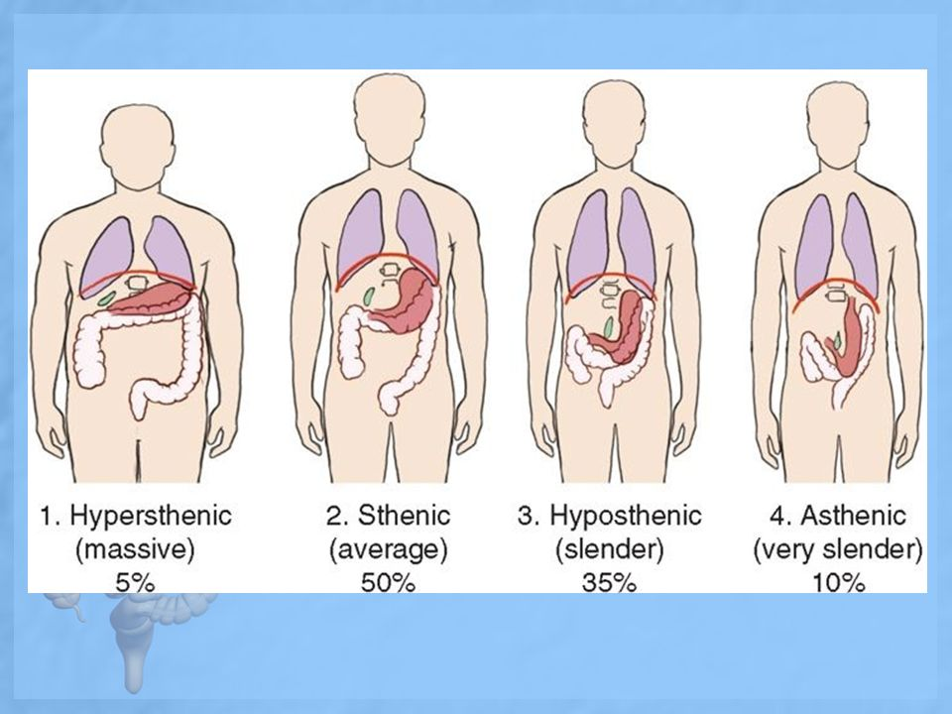

Slide 9
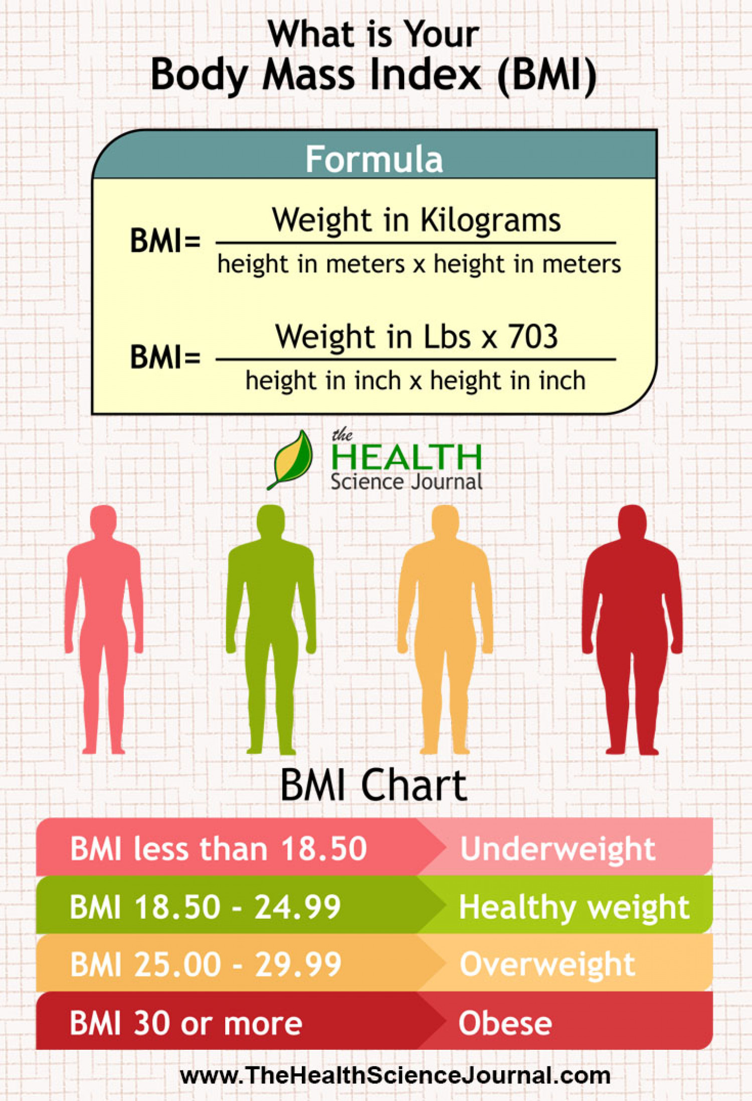

Slide 10
Overweighting and obesity
BMI | Classification^{[16]}
< 18.5 | underweight
18.5–24.9 | normal weight
25.0–29.9 | overweight
30.0–34.9 | class I obesity
35.0–39.9 | class II obesity
≥ 40.0 | class III obesity

Slide 11
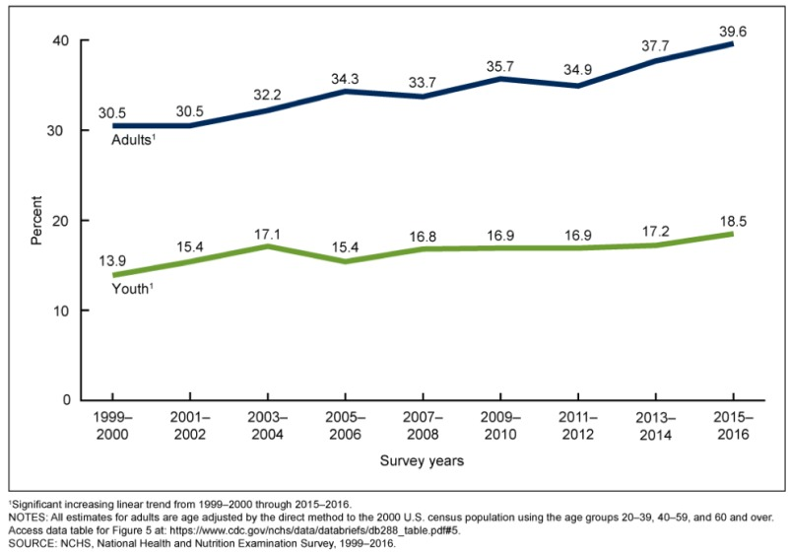

Slide 12
Waist Circumference
Norm | Abdominal (visceral) obesity
Men ≤40 inches (≤ 102 cm) | >40 in (> 102 cm)
Women ≤ 35 inches (≤ 88 cm) | > 35 in (> 88 cm)

Slide 13
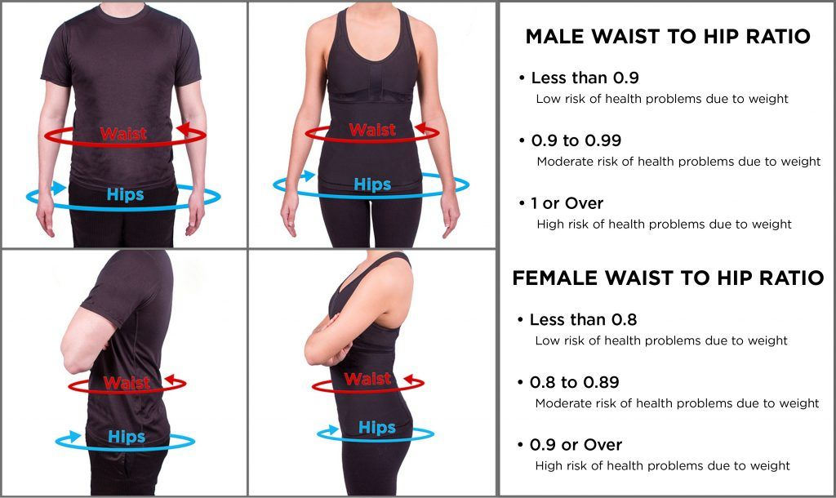
The waist-hip ratio or waist-to-hip ratio (WHR)

Slide 14
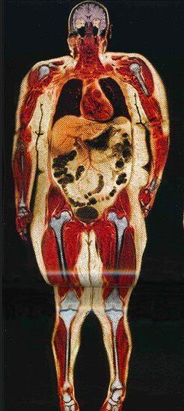
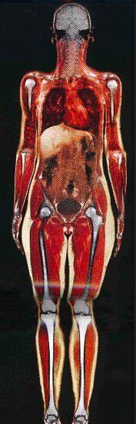
Body scan of one woman
113 kg and 55 kg.
Pay attention to the heart, liver, stomach, intestines, joints, etc.

Slide 15
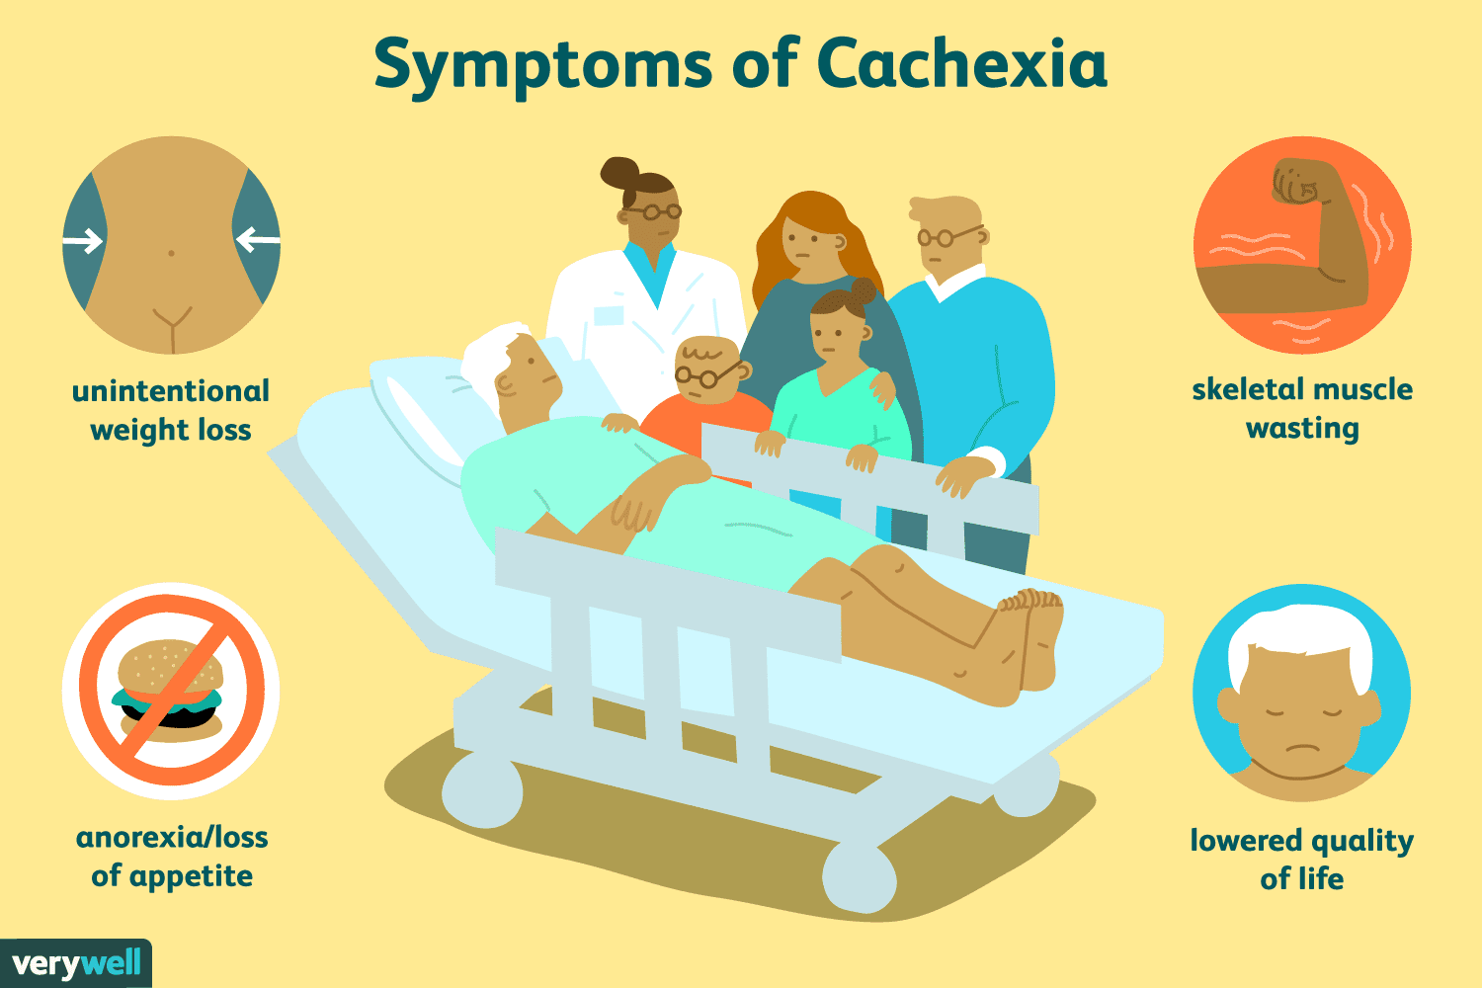
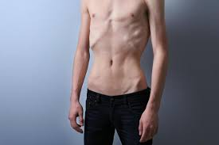
Weight loss
Cachexia

Slide 16
Face
Form
Shape
Appearance
Character
Face expression
Agitation

Slide 17
Diagnostic faces
Acromegalic
Cushing’s syndrome
Down’ s
Mixoedema
Facies Basedovica
Risus sardinicus
Hippocratic
Cyanosis
Facies febris
Facies Corvisar
Facies nephritica
Facies mitralis

Slide 18
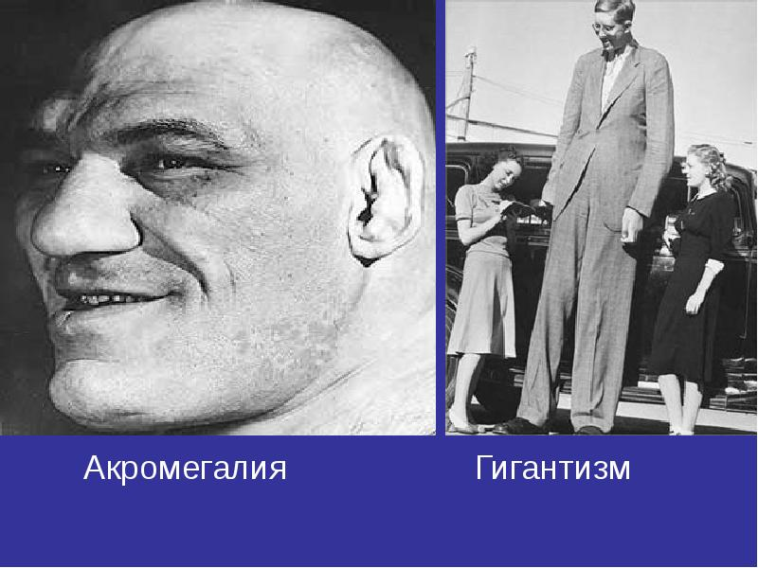
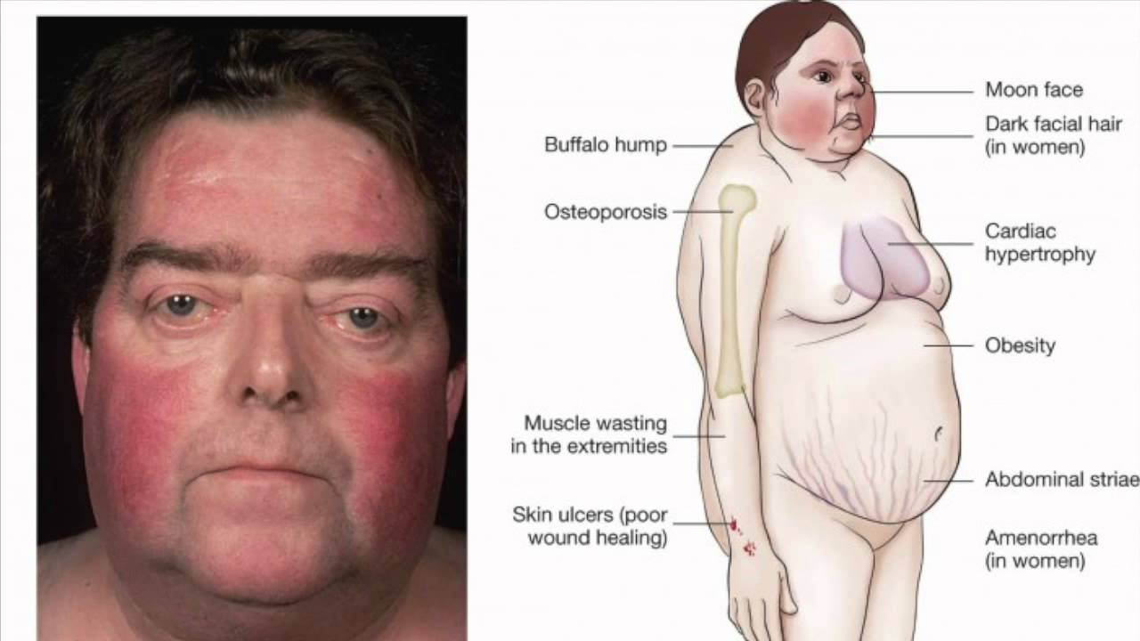

Slide 19
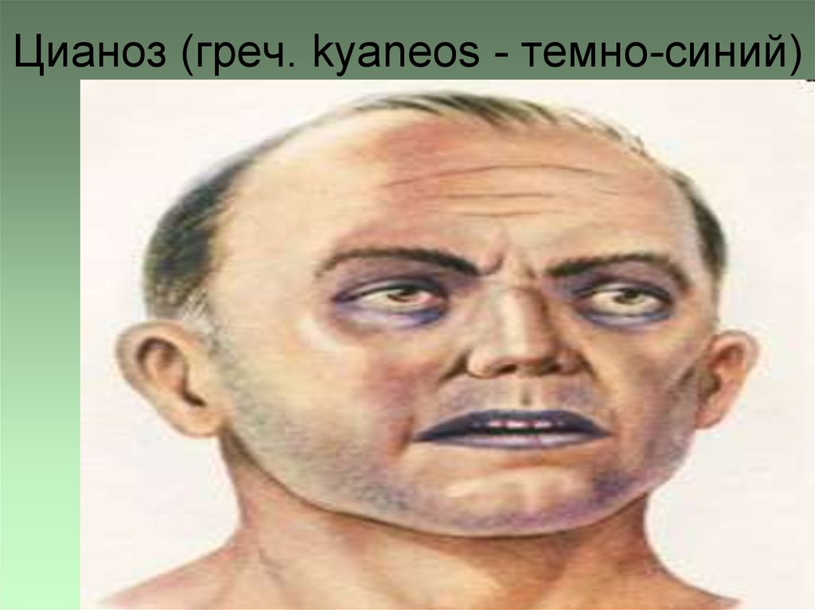
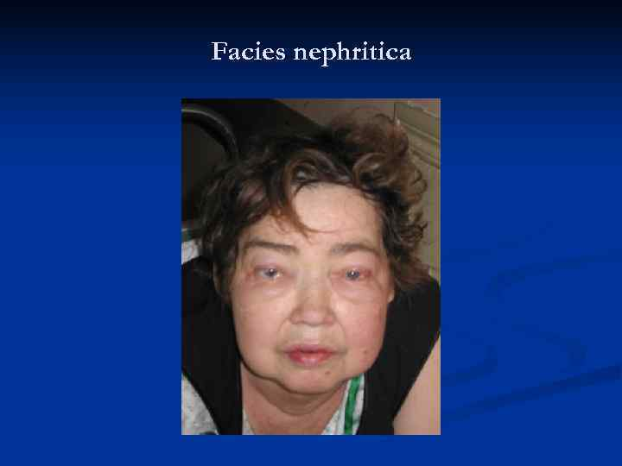
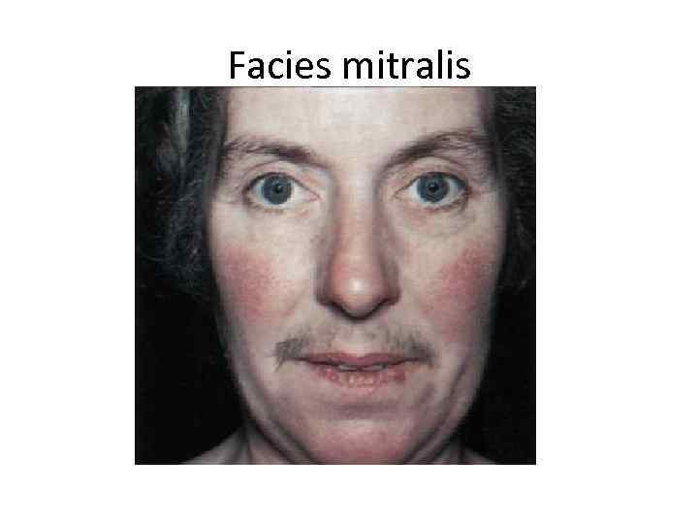
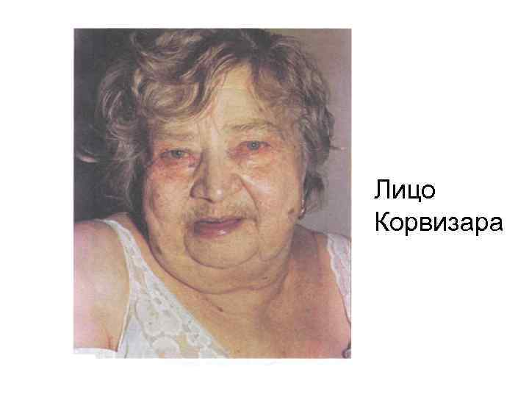

Slide 20
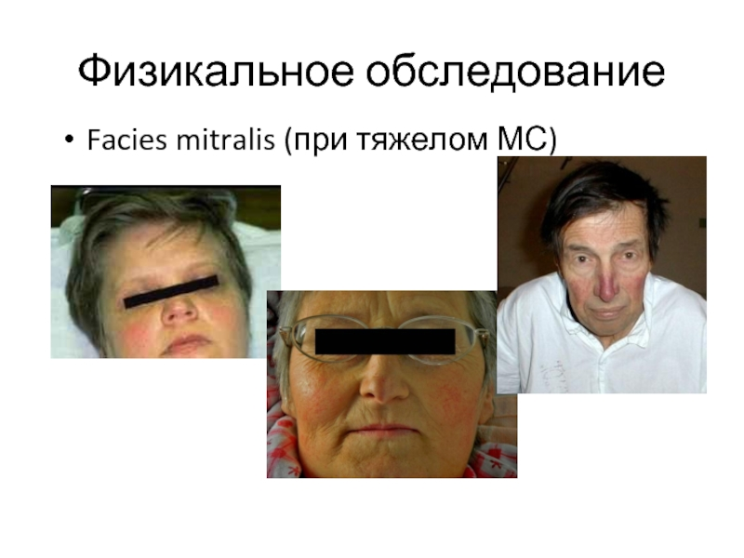

Slide 21
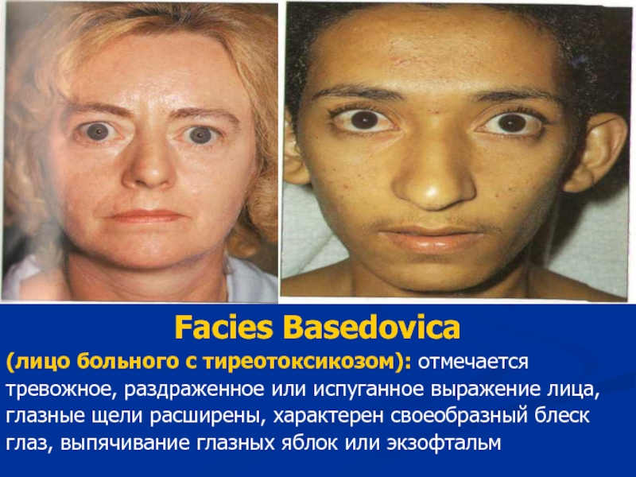

Slide 22
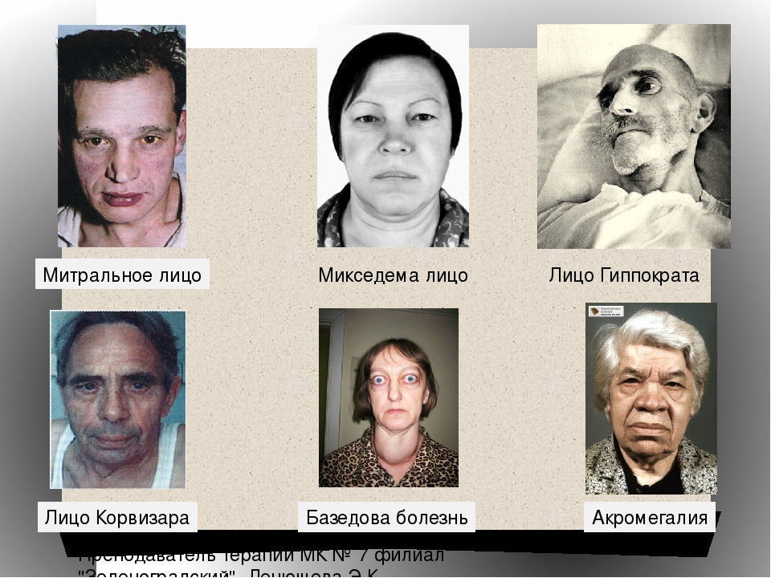

Slide 23
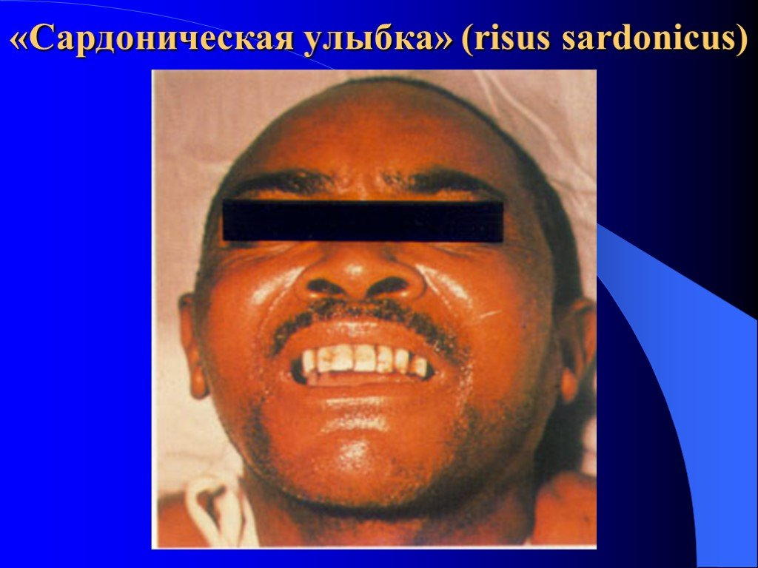

Slide 24
Skin color
Cyanosis – central / acrocyanosis
Pallor
Hyperemia
Jaundice - Icterus
Pigmentation – hyper, hypo
Rash=Exanthema

Slide 25
Skin – texture, hydration, turgor
smooth
rough
dry
wet
oily

Slide 26
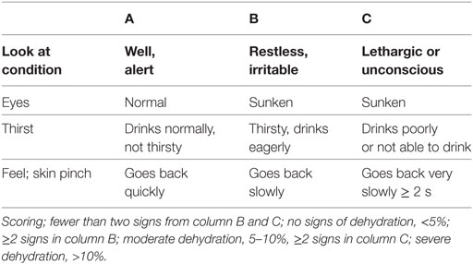
Dehydration signs

Slide 27
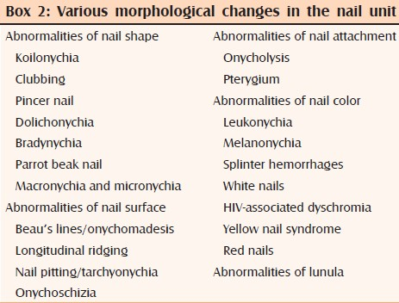
Nails

Slide 28
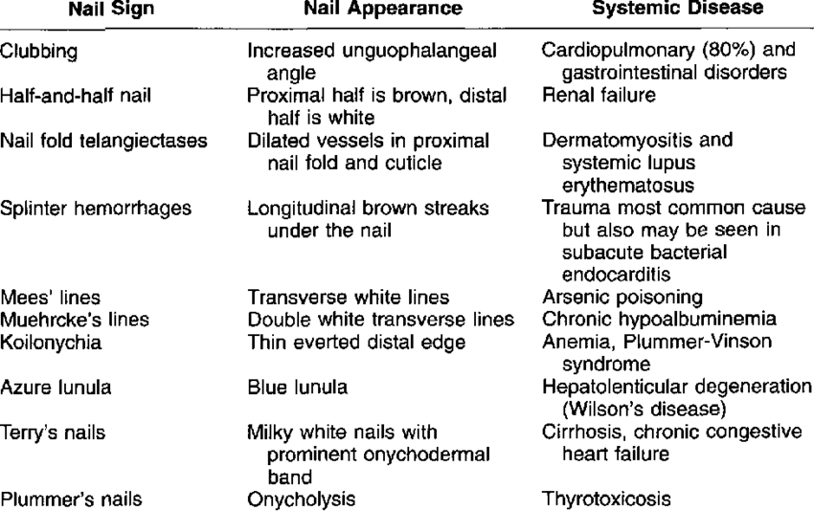

Slide 29
Vital signs
Body temperature
Pulse
Blood pressure
Respiratory rate

Slide 30
Body temperature
 | Normal | Fever
Mouth | 37,8 ˚C | >37,3˚C
Axilla | 36,4 ˚C | >36,9˚C
Rectum | 37,3 ˚C | >37,7˚C

Slide 31
Normal and febrile body temperature ranges (rectal temperatures)
Normal and febrile body temperature ranges (rectal temperatures).
BODY TEMPERATURE | °C | °F
Normal | 37–38 | 98.6–100.4
Mild/low grade fever | 38.1–39 | 100.5–102.2
Moderate grade fever | 39.1–40 | 102.2–104.0
High grade fever | 40.1–41.1 | 104.1–106.0
Hyperpyrexiaª | >41.1 | >106.0

Slide 32
Smell
Notable odour
The smell of rotting apples | Sickly sweet smell of patients with ketoacidosis – diabetes mellitus
the smell of chocolate | Sweet smell of acute lever failure
Fish breath | Ammoniacal – ureamic odour
Smell of sigarette | Smoking patient

Slide 33
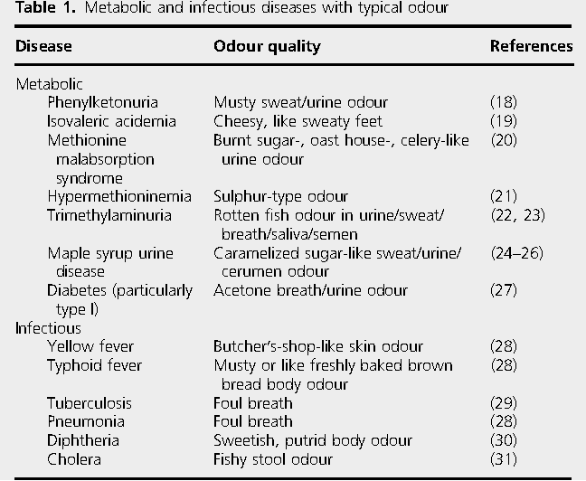

Slide 34
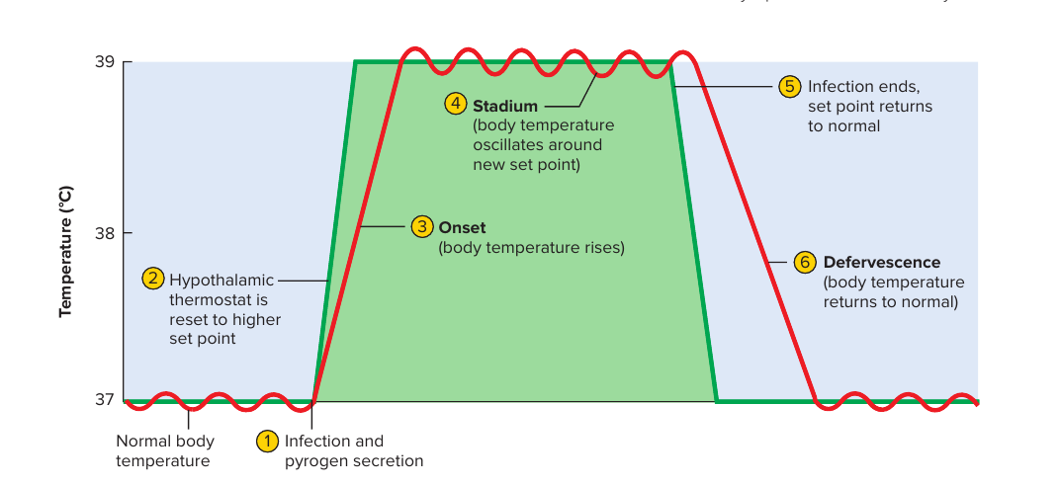
What symptoms (patient complaints, objective data) can you identify at each stage of the fever?

Slide 35
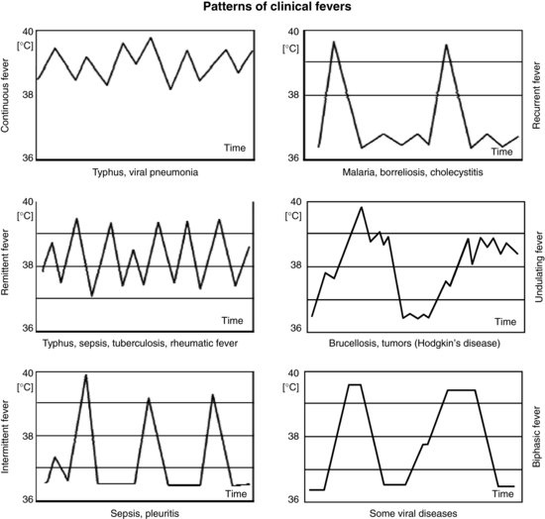

Slide 36
Lymphatic nodules
Location
Size | Normal nodes in adults are <0.5 cm in diameter
Attachments | Lymph nodes fixed to deep structures or skin suggest malignancy
Consistency | Normal nodes feel soft in Hodgkin’s disease they are characteristically ‘rubbery’, in tuberculosis they may be ‘matted’, and in metastatic cancer they feel hard
Tenderness | Acute viral or bacterial infection, including infectious mononucleosis, dental sepsis and tonsillitis, causes tender, variably enlarged lymph nodes

Slide 37
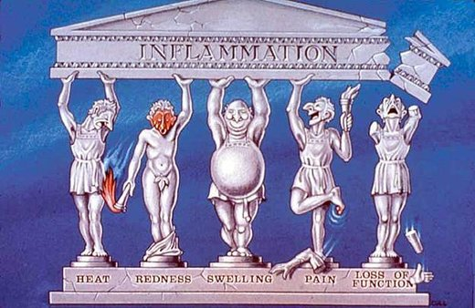
Calor Rubor Tumor Dolor Functio laesa

Slide 38
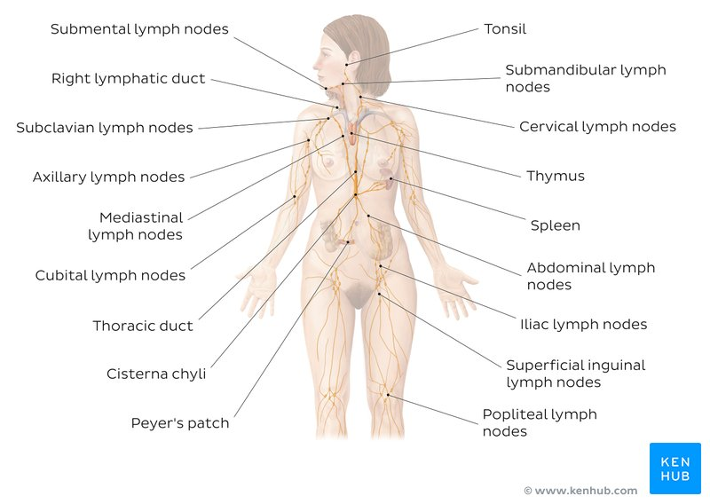

Slide 39
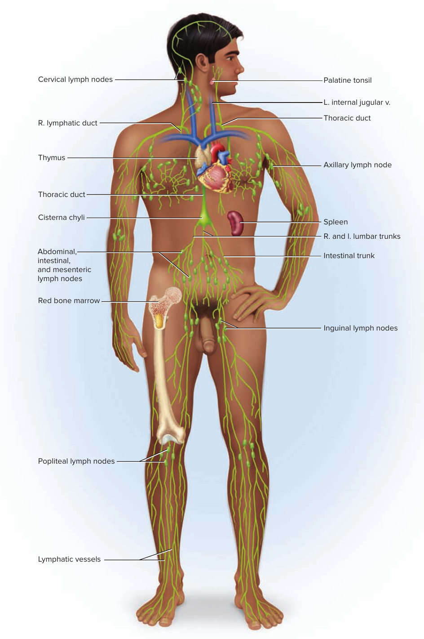

Slide 40
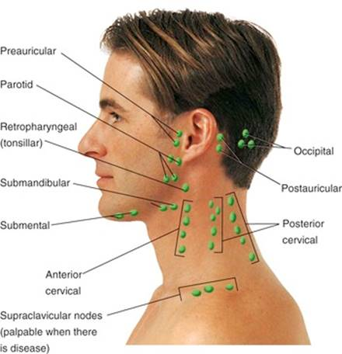

Slide 41
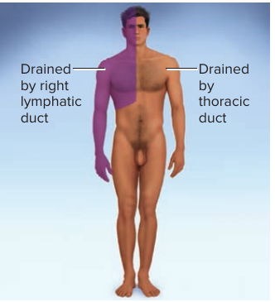

Slide 42
